Slide 1
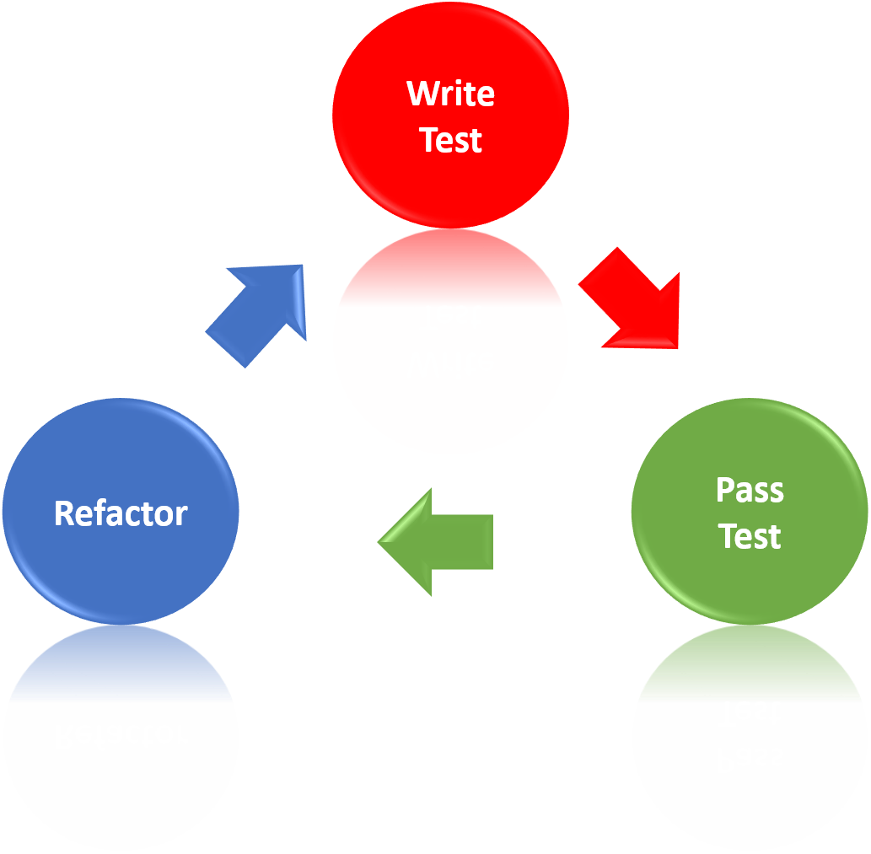
Mocking and Test-Driven Development
Learn the "Test First" Approach to Coding
SoftUni Team
Technical Trainers
Software University
https://softuni.bg

Slide 2
Table of Contents
Isolating Behaviors
Mocking
Test-Driven Development
Reasons to use TDD
Myths and Misconceptions about TDD

Slide 3
Have a Question?
sli.do
#csharp-advanced

Slide 4

Isolating Behaviors
Dependencies

Slide 5
Coupling and Testing (1)
Consider testing the following code:
We want to test a single behavior
Concrete Implementation
public class Bank {
private AccountManager accountManager;
public Bank()
{
this.AccountManager = new AccountManager();
}
public AccountInfo GetInfo(string id) { … }
}
Bank depends on AccountManager

Slide 6
Coupling and Testing (2)
Need to find solution to decouple classes
Interface
Bank inherits bugs
IAccountManager
+Account GetAccount()
Bank
AccountManager
uses
Bank

Slide 7
Dependency Injection
Decouples classes and makes code testable
public interface IAccountManager
{
Account Account { get; }
}
public class Bank
{
private IAccountManager accountManager;
public Bank(IAccountManager accountManager)
{
this.accountManager = accountManager;
}
}
Independent from Implementation
Injecting dependencies

Slide 8
Problem: Fake Axe and Dummy
Test if hero gains XP when target dies
You need to:
Make Hero class testable (use Dependency Injection)
Introduce Interfaces for Axe and Dummy
Interface IWeapon
Interface ITarget
Create test using a fake Weapon and fake Dummy

Slide 9
Solution: Fake Axe and Dummy (1)
public interface IWeapon
{
void Attack(ITarget target);
int AttackPoints { get; }
int DurabilityPoints { get; }
}
public interface ITarget
{
void TakeAttack(int attackPoints);
int Health { get; }
int GiveExperience();
bool IsDead();
}

Slide 10
Solution: Fake Axe and Dummy (2)
public Hero(String name, IWeapon weapon)
{
this.name = name;
this.experience = 0;
this.weapon = weapon;
}
Dependency Injection through the constructor
public class Axe : IWeapon
{
public void attack(ITarget target) { … }
}

Slide 11
Solution: Fake Axe and Dummy (3)
public class FakeTarget : ITarget
{
public void TakeAttack(int attackPoints) { … }
public int Health => 0;
public int GiveExperience() { return 20; }
public bool IsDead() { return true; }
}
// TODO: Implement FakeWeapon

Slide 12
Solution: Fake Axe and Dummy (4)
private const string HeroName = "Peter";
[Test]
public void HeroGainsExperienceAfterAttackIfTargetDies()
{
ITarget fakeTarget = new FakeTarget();
IWeapon fakeWeapon = new FakeWeapon();
Hero hero = new Hero(HeroName, fakeWeapon);
hero.attack(fakeTarget);
// Assert…
}

Slide 13
Fake Implementations
Not readable, cumbersome and has too much boilerplate
[Test]
public void TestRequiresFakeImplementationOfBigInterface() {
// Arrange
Database db = new BankDatabase()
{
// Too many methods…
}
AccountManager manager = new AccountManager(db);
// Act…
// Assert…
}
Not suitable for big interfaces

Slide 14

Mocking

Slide 15
Mocking
Mock objects simulate behavior of real objects
The object supplies non-deterministic results - Time
It has states that are difficult to create or reproduce - Network
It is slow - Database
It does not yet exist or may change behavior
It would have to include information and methods exclusively for testing purposes (and not for its actual task)

Slide 16
Moq Library
Moq provides us with an easy way of creating mock objects
Simple to use
Strongly typed
Minimalistic
Mock<IContainer> mockContainer = new Mock<IContainer>();
Mock<ICustomerView> mockView = new Mock<ICustomerView>();
Notes:
Moq
Moq (pronounced "Mock You") is an open-source mocking framework
Facilitates the mocking process by providing an API for creating fake objects (mocks)
No need to create fake classes for every possible test scenario
Can mock almost any type, not just interfaces
E.g. Random, DateTime, etc.

Slide 17
Mocking Example
Mock<ITarget> fakeTarget = new Mock<ITarget>();
fakeTarget
.Setup(p => p.TakeAttack(It.IsAny<int>()))
.Callback(() => hero.Weapon.DurabilityPoints -= 1);
fakeTarget
.Setup(p => p.Health)
.Returns(0);

Slide 18

Problem: Mocking
Include Moq in the project
Mock fakes from previous problem
Test if hero gains XP when target dies

Slide 19
Solution: Mocking
[Test]
public void HeroGainsExperienceAfterAttackIfTargetDies() {
Mock<ITarget> fakeTarget = new Mock<ITarget>();
fakeTarget.Setup(p => p.Health).Returns(0);
fakeTarget.Setup(p => p.GiveExperience()).Returns(20);
fakeTarget.Setup(p => p.IsDead()).Returns(true);
Mock<IWeapon> fakeWeapon = new Mock<IWeapon>();
Hero hero = new Hero("Pesho", fakeWeapon.Object);
hero.Attack(fakeTarget.Object);
Assert.That(hero.Experience, Is.EqualTo(20));
}

Slide 20

Test-Driven Development

Slide 21
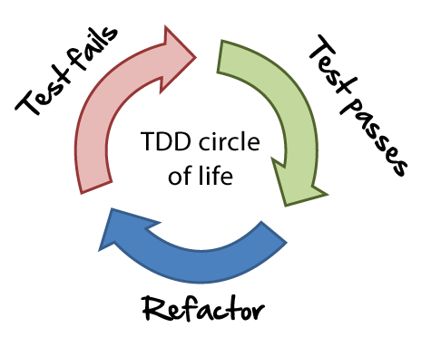
Unit Testing Approaches
"Code First" (code and test) approach
Classical approach
"Test First" approach
Test-driven development (TDD)
21

Slide 22
The Code and Test Approach
Write code
Write unit test
Run and succeed
Time flow

Slide 23
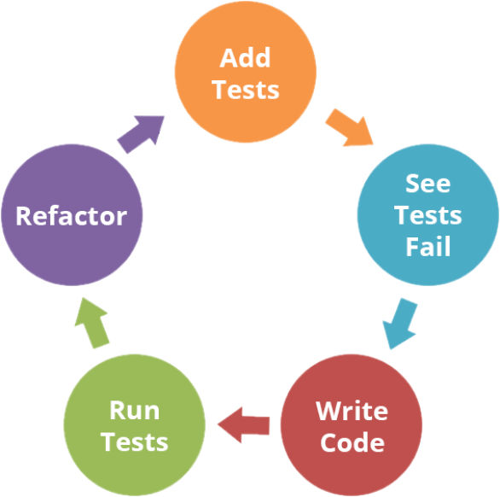
The Test-Driven Development Approach

Slide 24
Test-Driven Development (TDD)
Create a test list
Pick а test
Write test
Compile and fail
Write enough code to compile
Run test and fail
Write code to pass test
Time flow
Remove duplication

Slide 25
Why TDD?
TDD helps find design issues early
Avoids reworking
Writing code to satisfy a test is a focused activity
Less chance of error
Tests will be more comprehensive than if they are written after the code
25

Slide 26
Myths and Misconceptions
You create a 100% regression test suite
The unit tests form 100% of your design specification
You only need to unit test
TDD is sufficient for testing
TDD doesn't scale (partially true)
Your test suite takes too long to run
Not all developers know how to test
Everyone might not be taking a TDD approach

Slide 27

Summary
…
…
…
Code and Test
Write code, then test it
Test-Driven Development
Write tests first
Reasons to use TDD
Prevent some application design flaws
Manage complexity more easily

Slide 28
Questions?
Notes:
28

Slide 29










SoftUni Diamond Partners

Slide 30



Educational Partners

Slide 31
Trainings @ Software University (SoftUni)
Software University – High-Quality Education, Profession and Job for Software Developers
softuni.bg, about.softuni.bg
Software University Foundation
softuni.foundation
Software University @ Facebook
facebook.com/SoftwareUniversity
Software University Forums
forum.softuni.bg
31
Notes:
31

Slide 32

License
This course (slides, examples, demos, exercises, homework, documents, videos and other assets) is copyrighted content
Unauthorized copy, reproduction or use is illegal
© SoftUni – https://about.softuni.bg
© Software University – https://softuni.bg
Notes:
32

